Slide 1
Design Snapshot Template (part/owner)
Dimensions:
Operating Numbers:
Status:
(is this a concept/frozen/complete)
Last updated:
Assumptions/notes:
Add pictures if you want:

Slide 2
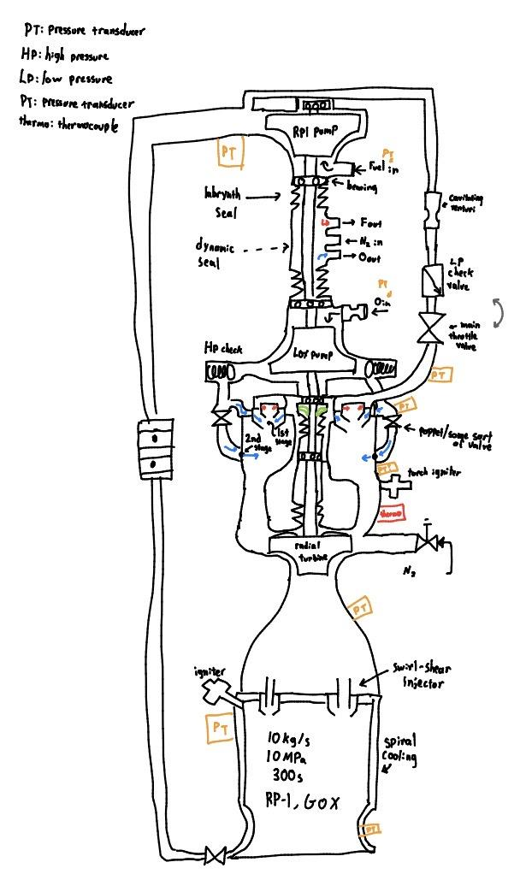
Preliminary design operating conditions can be found here: Turbopump design(radial turbine) - Google Sheets
Apologize for poor formatting (contact kei if want cleaned)
Current Engine Design layout
Status: Current design theory Assumptions/notes:
Still figuring out what exactly we want to do for the pump outlets to the preburner
Start up method (nitrogen kickstart)could be different
Haven't decided what kind of valve to use for the valve that says electric
Lifting seal
Last updated: 3/23/26

Slide 3
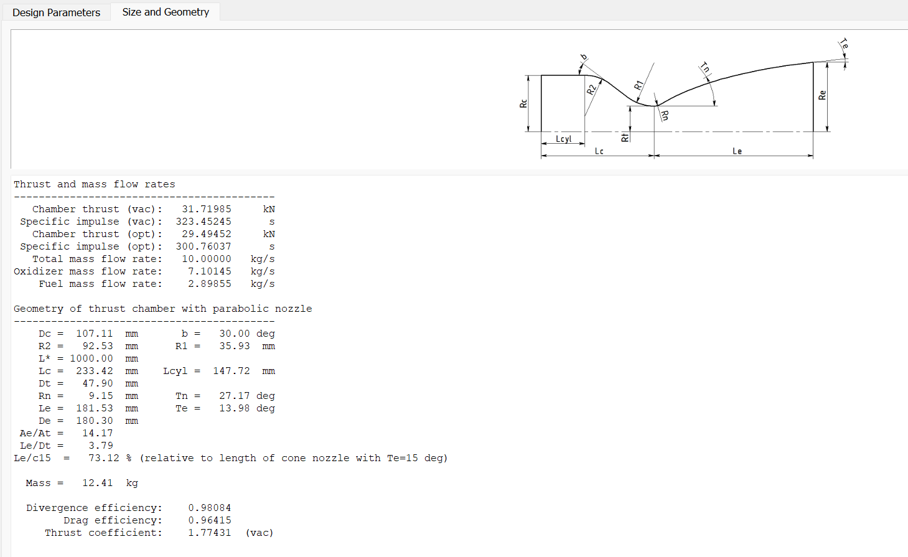
Information for Fluids
Whole engine Thrust, massflow
Sensor Information: Sensors:
engine parameters
Feedback Appreciated about what/how information should be presented
Last updated: 4/20/26

Slide 4
Information for Electronics
Sensor Information: Sensors:
Feedback Appreciated about what/how information should be presented
Last updated: 3/23/26

Slide 5
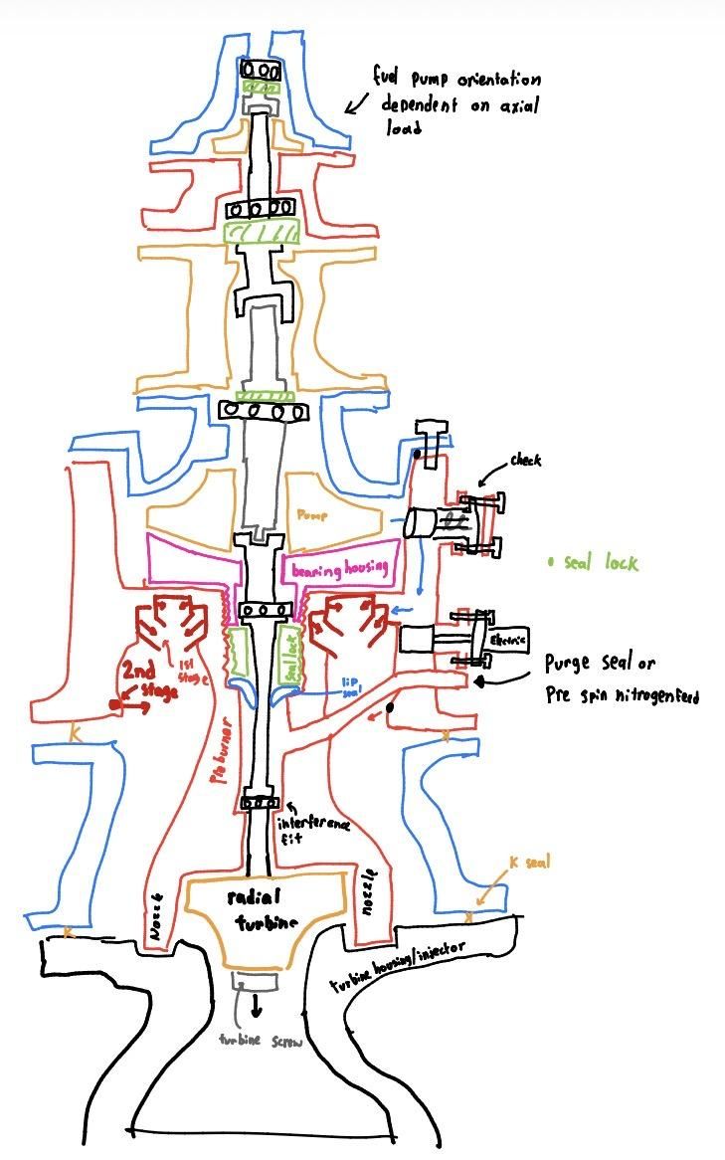
Conceptual assembly/parts

Slide 6
Sensors:
Important sensors:
Thermocouple(vital) to detect combustion in preburner + Information to throttle engine
PT in preburner chamber/ before chamber:
Information useful to throttle engine
PT in combustion chamber/ before combustion chamber:
Important data
PT accuracy: TBD
PT frequency: TBD
Thermocouple accuracy: TBD
Thermocouple frequency: TBD
Future work: table with each PT, thermocouple number and requirements
Last updated:3/23/26

Slide 7
Parts to Test(ideas)
Turbine/pumps:
Test nitrogen kickstart of turbine:
Purpose: verify startup power
Water flow test of pumps:
Purpose: pump performance verification
Other considerations:
TBD
Preburner:
test at initial ignition pressure:
Purpose: verify ignition timing is correct
hydrostatic test at operating pressure
Purpose: verify structural integrity at operation pressure
Other considerations:
Ask nasa if we can test using their equipment at operation pressure,temp
Purpose: verify performance of preburner(correct delta P, temperature,structural, thermal)
Igniter:
test at initial ignition pressure:
Verify igniter performance
Other considerations:
TBD
Last updated:3/23/26

Slide 8
Startup Sequence
Turbopump is spun using nitrogen kickstart.
Rising pump discharge pressure opens propellant check valves (passive). Fuel check valve likely opens first (pending timing analysis)
First-stage propellants enter the preburner and ignition occurs.
Ignition confirmed via thermocouples.
Poppet valves open, allowing second-stage LOX injection.
Notes:
will try to remove poppet valves based on combustion dynamics, pending timing analysis need
Timing is TBD
Last updated:3/23/26

Slide 9
Shutdown Sequence
TBD
Last Updated:3/23/26

Slide 10
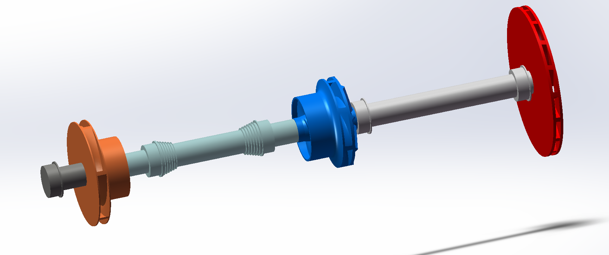
Shaft Overall Dimension - Ken

Slide 11
Stepped Labyrinth Seal - Ken

Slide 12
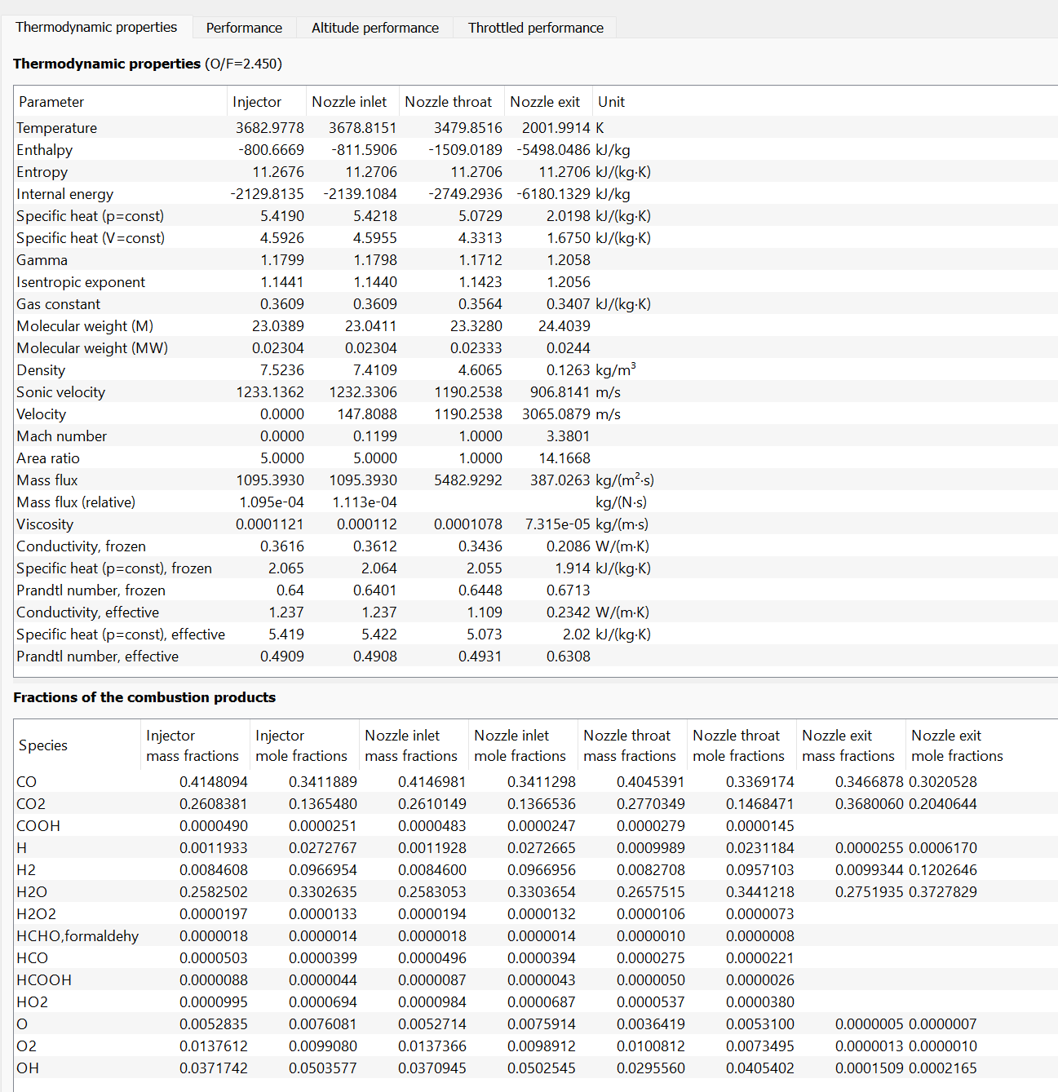
Combustion Chamber - Kei/Ashton
Dimensions: (the picture doesn’t depict shape correctly)
Operating Numbers:
Status:
Frozen: need to finish cad + ansys verify
Last updated:2/7/26
Assumptions/notes:
RPA is correct with channel cooling calculations(need to verify with ansys)
Using printed Gr-cop42

Slide 13
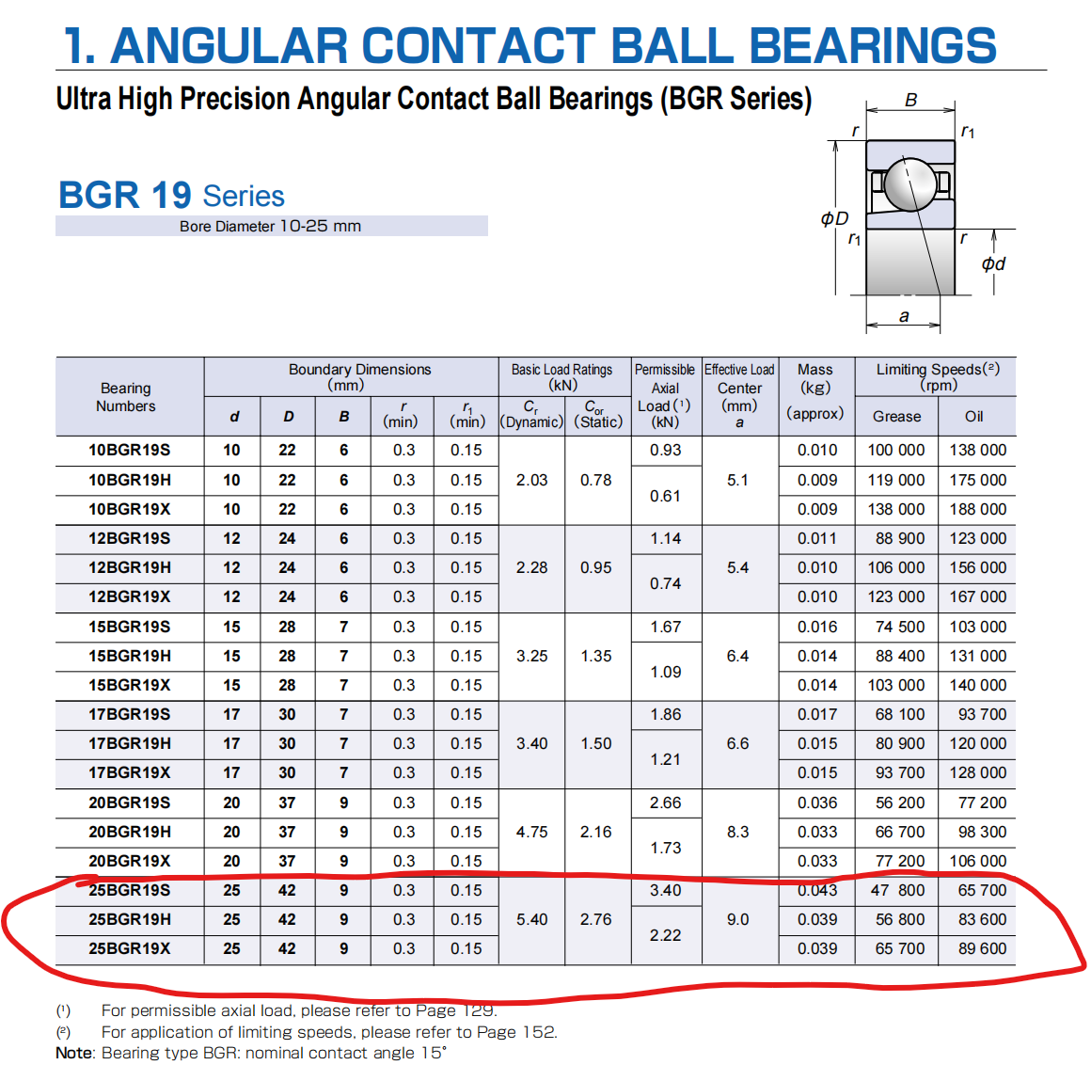
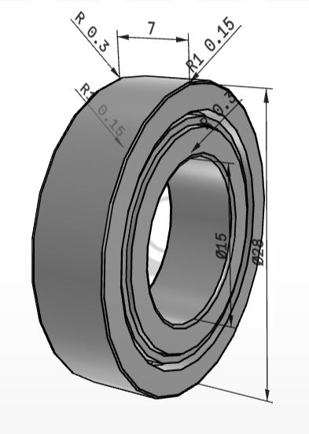
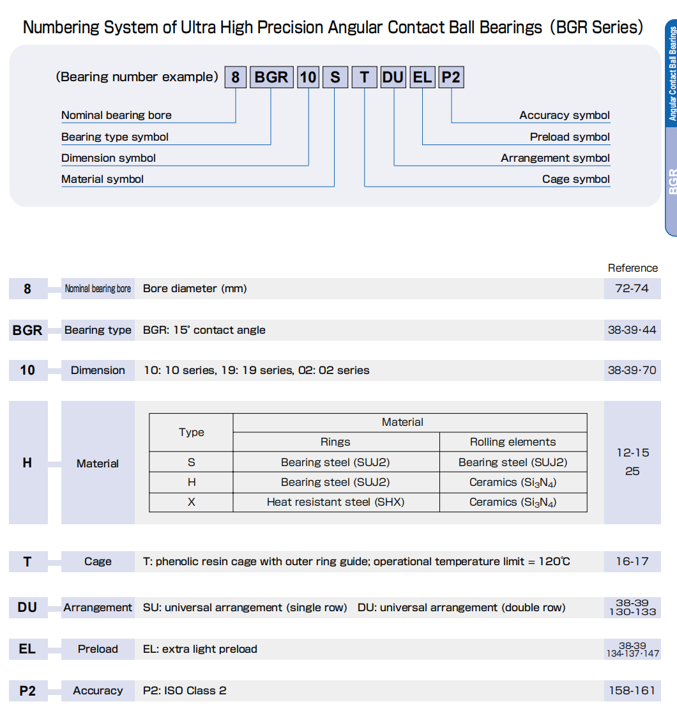
Bearing - Ken
25BGR19 Series: likely with brass cage
How to read the numbers
Bearing information

Slide 14
Preburner Flange - Kei
link to bolts
Size: M16
Bolt number: 24
Grade: 12.9
(the design numbers for gasket is in kenesto )
Last updated: 4/2/2026

Slide 15
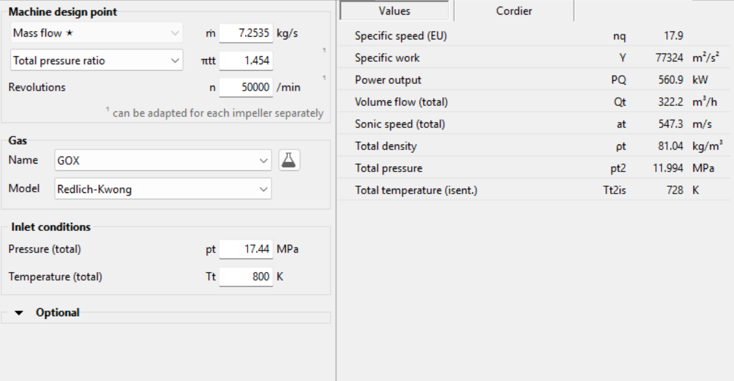
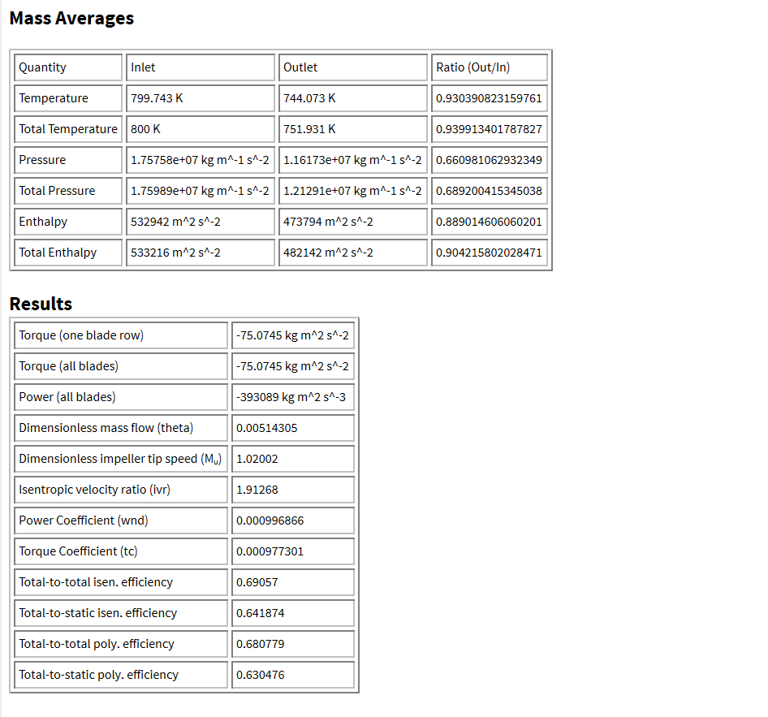
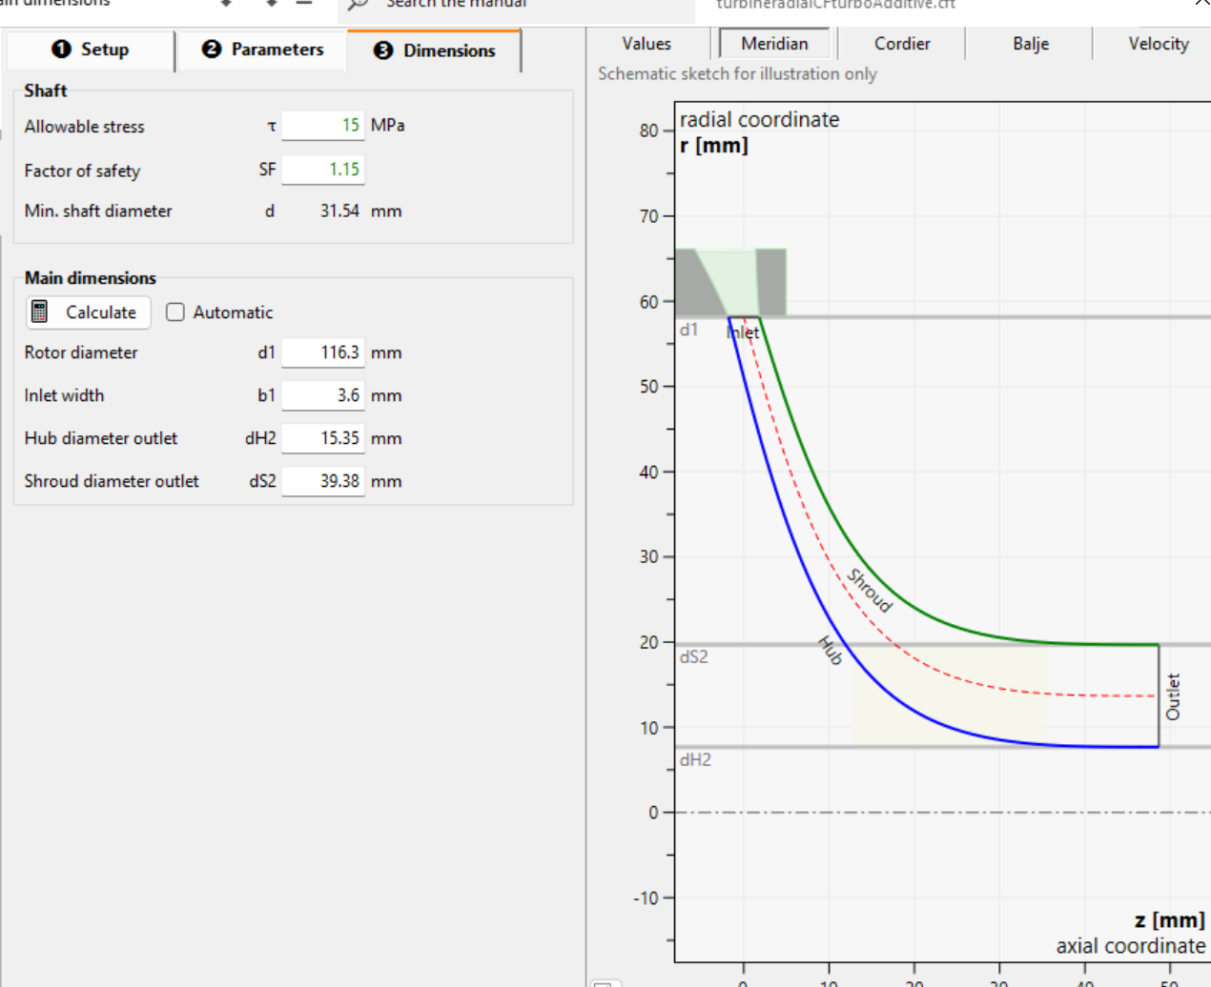
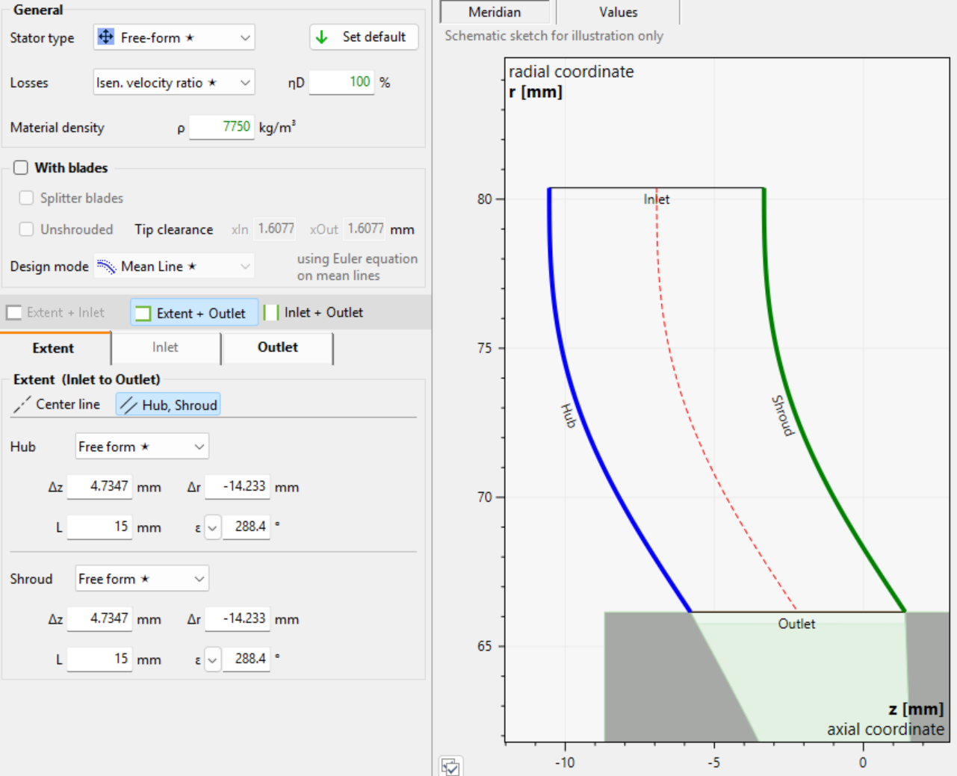
Status: complete
Last updated: 3/9/26
Assumptions/notes:
Using printed Inconel 718, with printer that can print 7-10 degree overhang
Flow Properties: power and efficiency likely overestimated around 10-15%(not 100% sure) (more accurate sim is planned)
Turbine rotor/inlet - Kei
Dimensions(flow dimensions):
Rotor Diameter: 116.3mm
Stator Diameter: 144.3mm
Stator inlet width: 3.6mm
Outlet Hub Diameter: 15.35mm
Outlet shroud Diameter: 39.38mm
Operating Numbers:
Flow Properties:
Axial force: about 8kN (need to cross check with hand calc)
Leak pressure: 14MPa
Axial force: 7.87KN

Slide 16
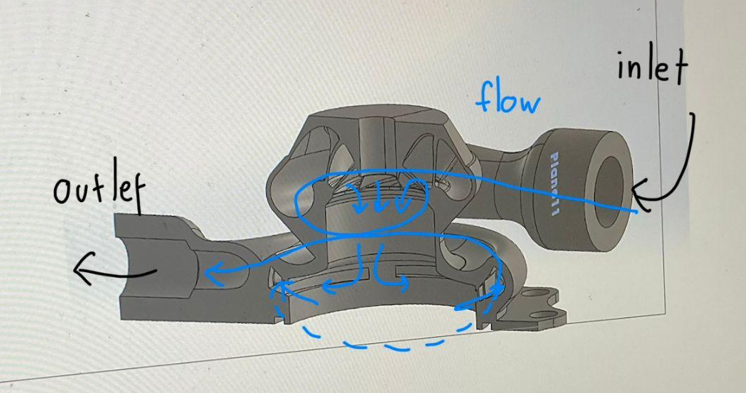
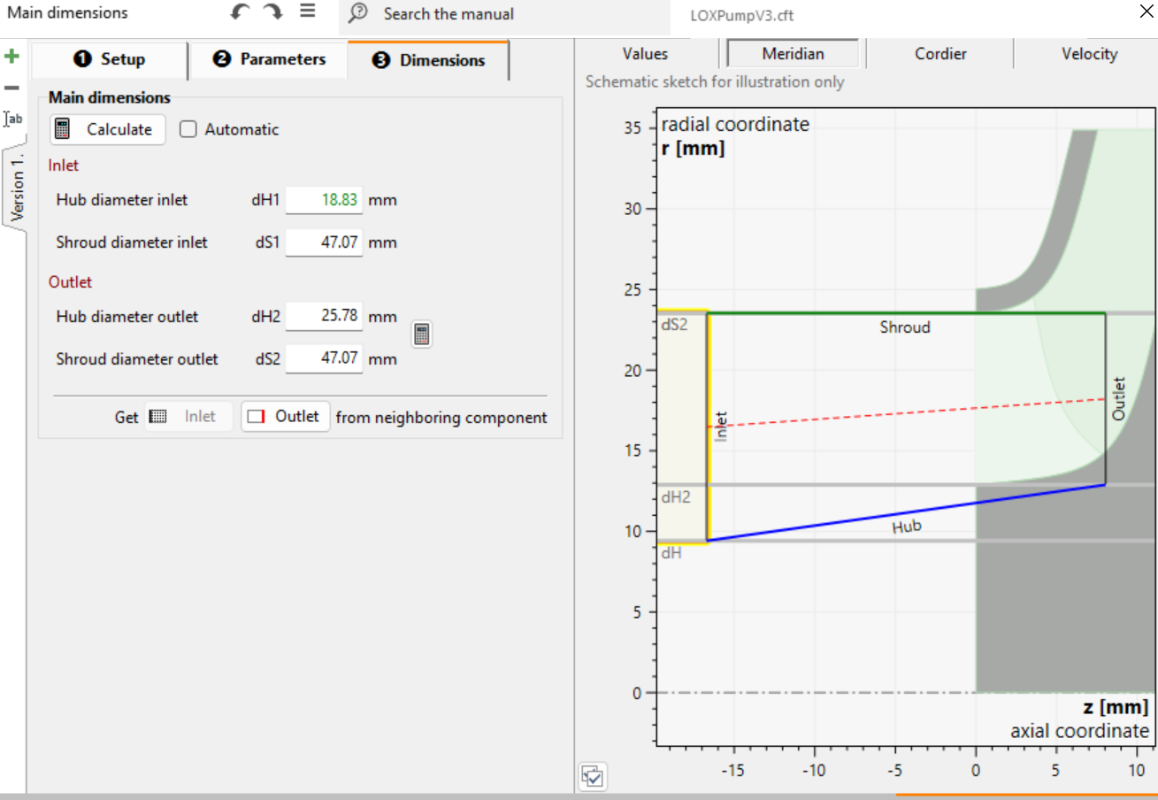
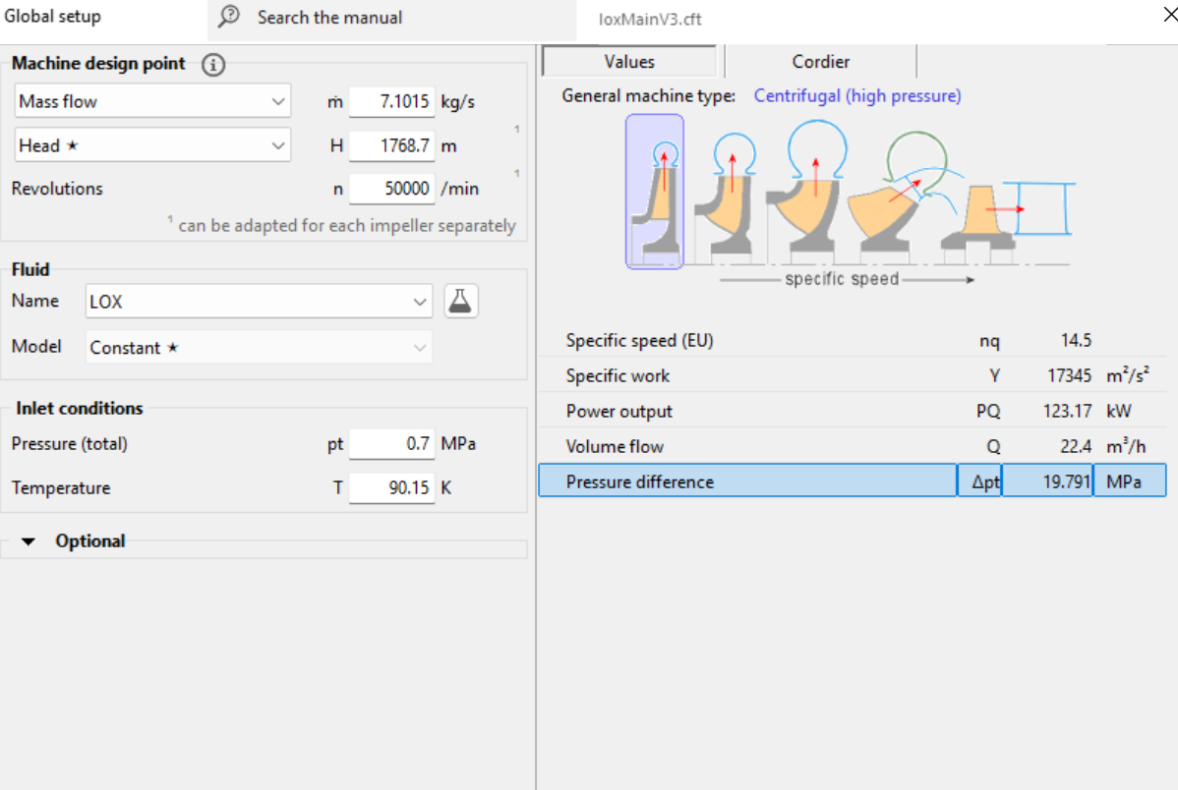
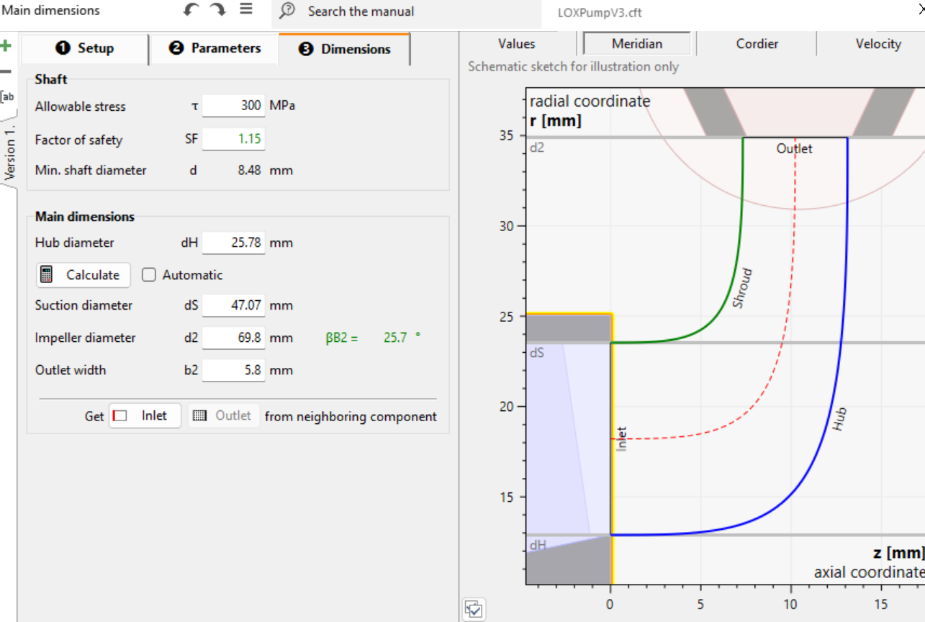
LOX pump rotor- Kei
Dimensions:
Operating Numbers:
Inlet pressure:0.7MPa
Outlet pressure: 20.5MPa
RPM: 50k
Axial force: TBD
NPSHr: TBD
Status:
Concept: completed, verified with ansys
Last updated: 2/25/2026
Assumptions/notes:
Using printed Inconel 718, with printer that can print 7-10 degree overhang
Diameter of the shaft doesn’t change 18mm

Slide 17
Fuel pump rotor
sim results
Simmed:
Leak Pressure: 6bar
Pout : 23MPa
Axial force: 10.5kN
Efficiency: 0.387487
Head:2834.37 m
Power: 208347 kg m^2 s^-3
Torque: 39.7913 kg m^2 s^-2

Slide 18
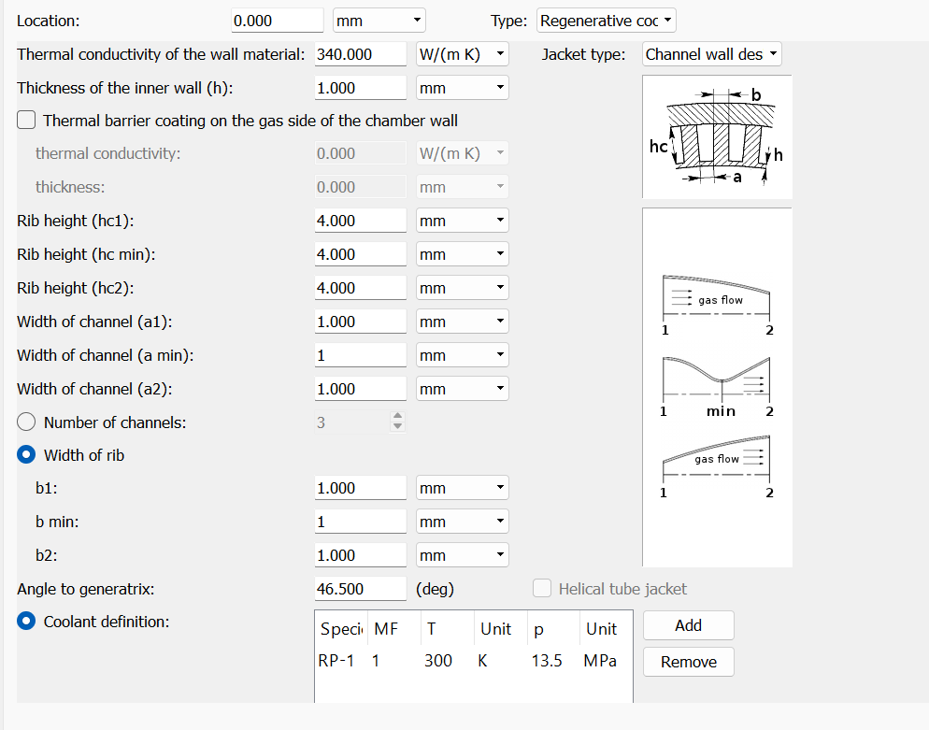
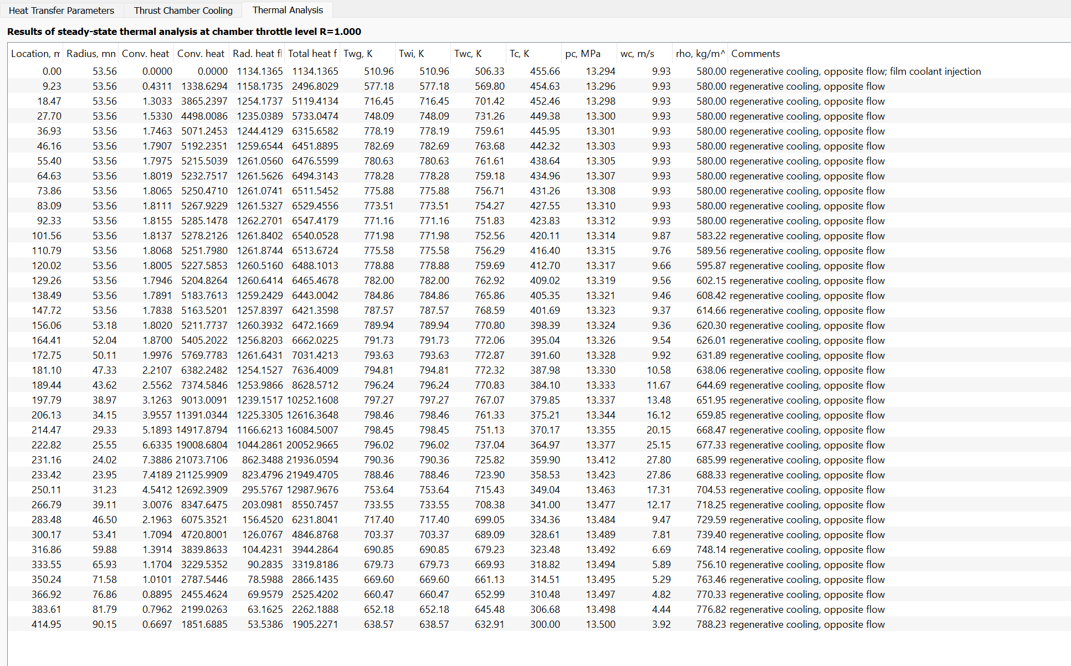
Cooling Channel - Kei
Dimensions:
Operating Numbers:
Status:
Concept: need to figure out how to make large pressure drop cooling channel(redesign needed)
Last updated: 2/7/26
Assumptions/notes:
RPA calculations of cooling channels are correct, print using Grcop 42
Note: The pressure calculations are not correct

Slide 19
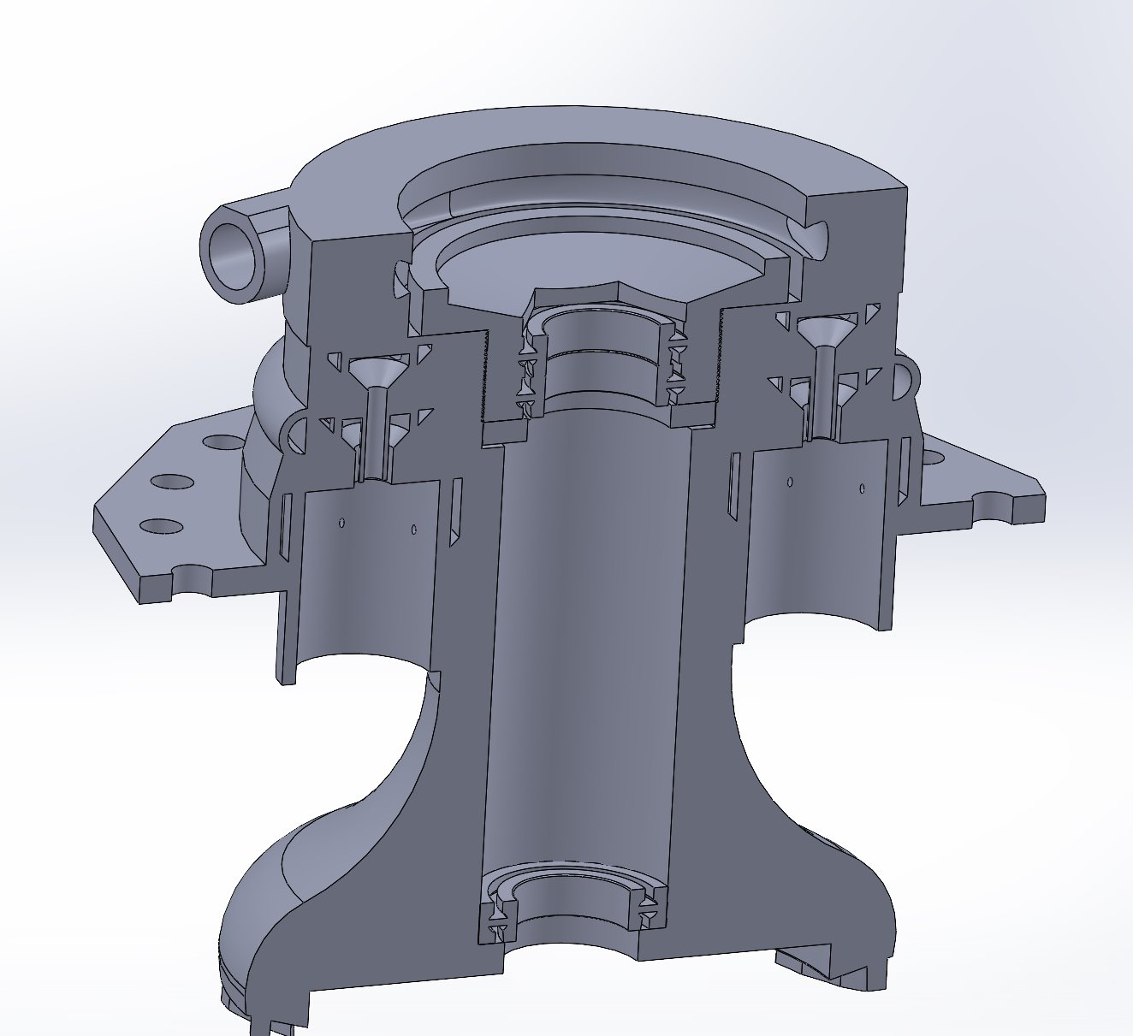
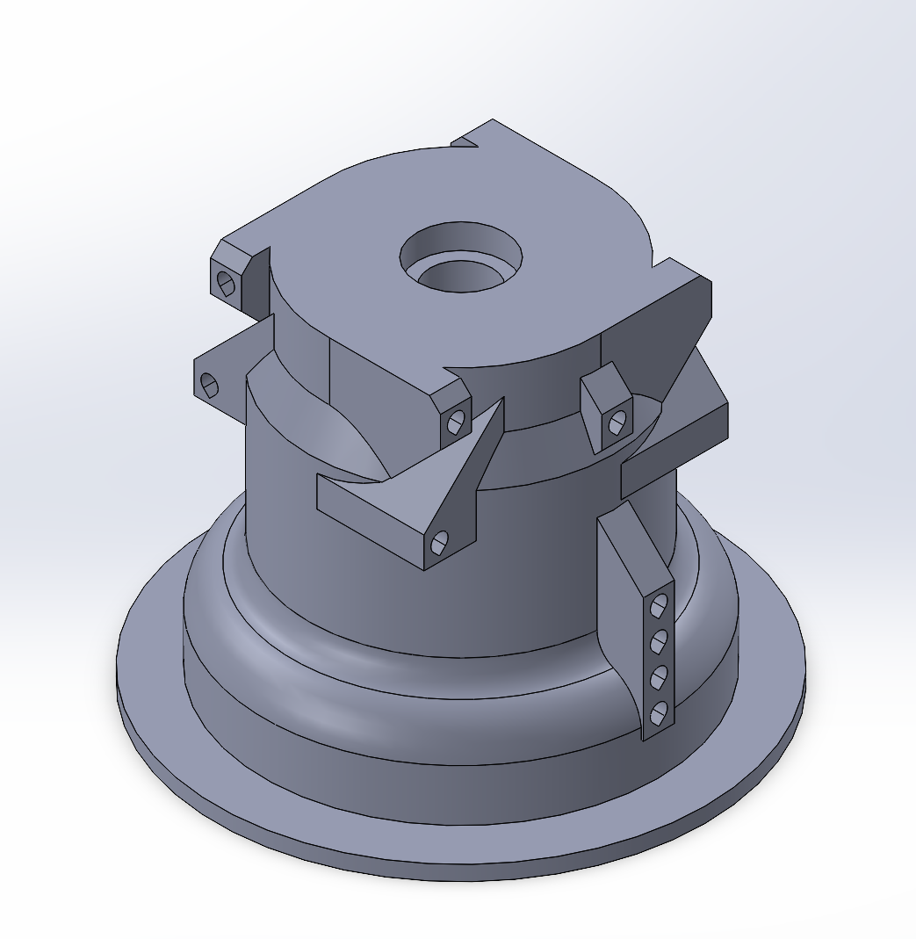
Operating Numbers:
Injector inlet Pressure | 20.6 Mpa | Stage 1 Flame Temp | 2993.76 K
Chamber Pressure | 17.51 Mpa | Stage 2 Flame Temp | 704.99 K (subject to change to 800K)
Stage 1 Fuel Mdot | 0.15509 kg/s | Stage 1 Lox Mdot | 1.39581kg/s
Stage 2 Lox Mdot | 5.83909kg/s | Total Lox Mdot | 7.2349 kg/s
Stage 1 O/F | 9 | Stage 2 O/F | 46.65
Stage 1 Hot Gas Density | 2.1933 kg/m^3 | Stage 2 Hot Gas Density | 8.3942 kg/m^3
Material | Inconel 718 | Combustion chamber length
Second Stage Mixing time | 0.003s | Stage 1 Hot Gas Combustion Time | 0.002s
Stage 1 Hot gas Velocity | ~33m/s | Hot Gas Exit Velocity chamber
Mixing Length Stage 2 |  | Hot gas velocity into stator | ???
Mach 1 of hot gas | 523.5 m/s
Oxygen Rich Ring Burner - Max
Dimensions:
Status: concept
Last updated: 3/2/2025
Assumptions/notes:Need to figure out four purge ports along shaft, & need to figure out seal at bottom

Slide 20
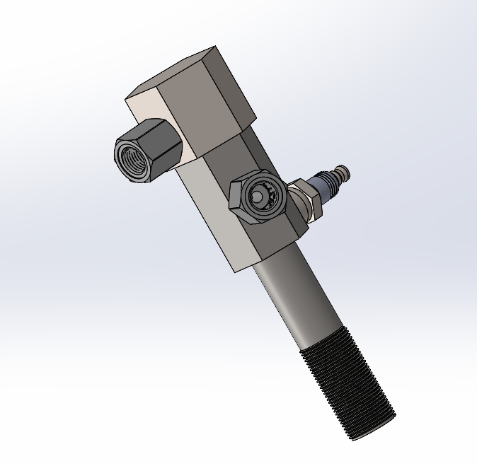
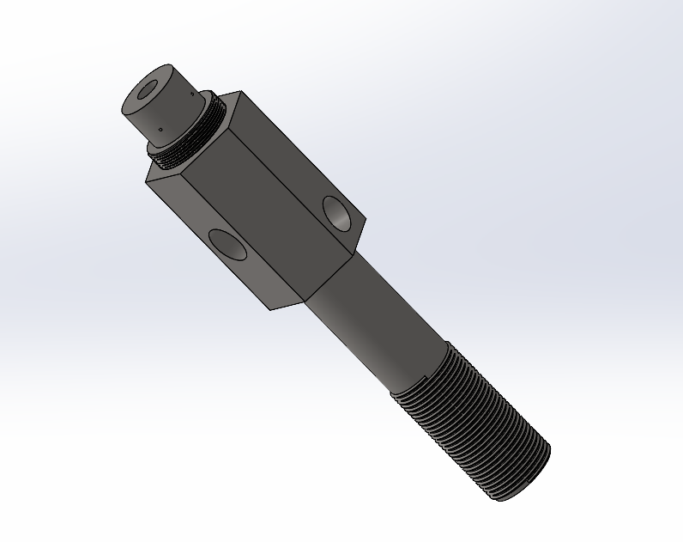
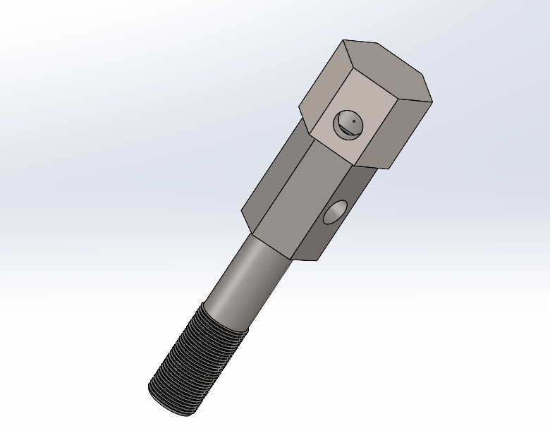
Torch Igniter- Corbin | Status: Ready for Testing, Needs Valve
Dimensions:
Whole Body: 3”x5”
Swirl Chamber Diameter: 4.5 mm
Swirl Chamber Length: 6.75 mm
Torch Tube Exit Diameter: 6.5 mm
Operating Conditions:
Pressure: 19.14 MPa
Adiabatic Flame Temperature: 1522 K
Propane Mass Flow: 0.142844484 g/s
GOx Mass Flow: 0.164271156 g/s
O/F Ratio : 1.15
Fig. 1: Igniter with cap, fittings, and spark plug
Fig. 2: Igniter boud with no cap, fittings or spark plug
Fig. 3: Igniter with cap and no fittings nor spark plug
Root Excel File:
Torch Igniter Excel

